Slide 1

GERD
is common
Studies show approximately
1 in 3
people suffer from it
Notes:
GERD is one of the most common medical conditions. Studies suggest that approximately one-third of the population suffers from GERD.

Slide 2
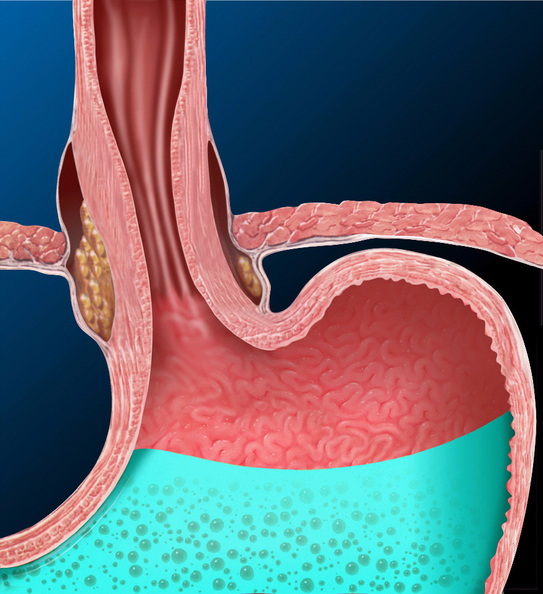
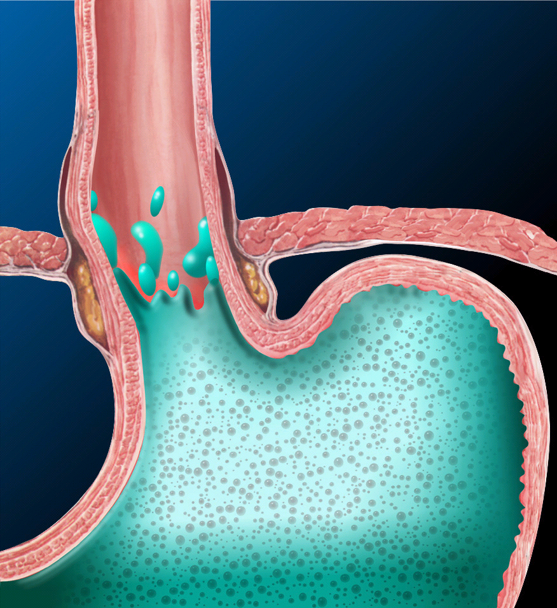
What is GERD?
Normal LES - closed
LES in reflux - GERD
Notes:
Gastroesophageal Reflux Disease (or GERD) occurs when the Lower Esophageal Spincter (or LES), does not close properly and stomach contents leak back, or reflux, into the esophagus.
When the LES is inappropriately relaxed (or open), refluxed stomach acid contacts the lining of the esophagus, causing a burning sensation in the chest or throat called heartburn. Occasional heartburn is common and does not necessarily mean one has GERD. Heartburn that occurs more than twice a week is chronic and may be considered to be GERD.

Slide 3
GERD Symptoms
Persistent heartburn
Acid regurgitation
Chest pain
Chronic Cough
Chronic Sore Throat
Laryngitis - hoarseness
Asthma
Pain or trouble swallowing
Notes:
The main symptoms of GERD are persistent heartburn and acid regurgitation. Some people have Reflux without heartburn. Instead, they experience pain in the chest, hoarseness, or trouble swallowing. Others may experience heartburn without actual reflux of acid or food.

Slide 4
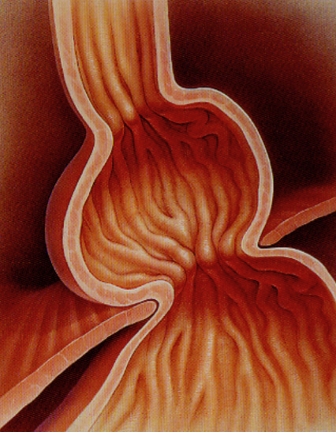
GERD Why?
No one knows for sure
Lifestyle factors can contribute
Hiatal hernia makes it easier for acid to reflux
Notes:
No one knows exactly the underlying cause of GERD, but a hiatal hernia or lifestyle factors may contribute.
When a hiatal hernia is present, it is easier for the acid to reflux. In this way, a hiatal hernia can contribute to reflux. A hiatal hernia can happen in people of any age; many otherwise healthy people over 50 have a small one.

Slide 5
GERD – Lifestyle Factors
Alcohol use
Obesity
Large or late night meals
Pregnancy
Smoking
Stress
Weight training
Notes:
Lifestyle factors that can contribute to GERD are: Alcohol use, obesity, eating large or late night meals, pregnancy, smoking, stress, weight training.

Slide 6
GERD – Food Triggers
Citrus fruits
Chocolate
Drinks with caffeine
Fatty and fried foods
Garlic and onions
Mint flavorings
Spicy or tomato based foods
Notes:
Certain foods can be associated with reflux events. Some triggers are citrus fruits, chocolate, drinks with caffeine, fatty or fried food, garlic and onions, mint flavorings and spicy or tomato based foods

Slide 7
How is GERD Diagnosed?
Symptoms respond to anti-acid meds
Your physician may look into your esophagus for signs of inflammation of the tissue (endoscopy)
You may take a 24-hour pH test which determines the amount of acid in your esophagus
Notes:
There are many ways to tell if you are suffering from GERD. If your symptoms respond to anti-acid medications, you most likely have GERD. Your physician may also perform a diagnostic test on you called endoscopy whereby a scope is placed down your esophagus to look at the tissue. In GERD patients, the esophageal lining is often inflamed. There is also a 24 hour pH test that detects the presence of acid in your esophagus.

Slide 8
For most patients medications control their symptoms…
1 in 3
…but as many as
people with GERD don’t respond
to PPIs…and many more are concerned about the risks of
long term medication.

Slide 9


GERD Treatments
Medical
Management
Endoluminal
Therapy
Invasive
Surgery
Notes:
Treatment options for GERD are provided in a tiered approach beginning with lifestyle changes, then progressing to medications. If patients do not respond to those conservative measures they can proceed to minimally invasive therapy such as Stretta then on to invasive surgery or implants.

Slide 10
Lifestyle Changes
Stop smoking and drinking alcohol
Lose weight if needed
Eat small meals and avoid lying down for 3 hrs after meals
Wear loose clothes
Raise head of bed 6-8 inches
Notes:
For Lifestyle Changes - Patients should:
• Stop smoking and drinking alcohol
• Lose weight if needed
• Eat small meals and avoid lying down for 3 hours after meals
• Wear loose-fitting clothes - and
• Try raising the head of their bed 6 to 8 inches

Slide 11
Medications
Over-the-counter antacids
H2 blockers
Protein Pump Inhibitors (PPIs)
Prokinetics
Notes:
Medications for GERD may include over the counter antacids, H2 blockers or PPIs that impede or block acid production, or Prokinetics to help make the stomach empty faster.

Slide 12
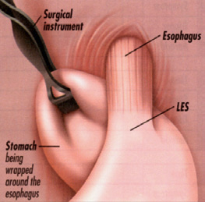
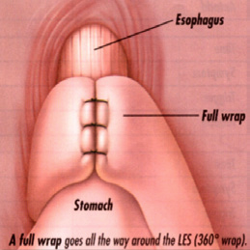
Nissen Fundoplication Surgery
Can be done as standard surgery or as a laparasopic procedure
Also incisionless fundoplication can be performed transorally
Notes:
A Nissen fundoplication is the standard surgical treatment for GERD. The upper part of the stomach is wrapped around the LES to strengthen the sphincter and prevent acid reflux and to repair a hiatal hernia. Fundoplication can be done as a minimally invasive procedure, through small incisions in the abdomen and also transorally with no incisions.

Slide 13
Minimally Invasive Stretta Therapy
If lifestyle changes and medications have failed to control GERD symptoms
If long term medications are not a good option due to possible side effects
Effective and minimally invasive option
Notes:
If you are not responding to lifestyle changes and medications or don’t wish to stay on long term PPIs because of side effects – but do not wish to undergo any kind of surgical fundoplication – Stretta therapy is a good option. Stretta is an effective and minimally invasive procedure that improves the function of the LES and improves the symptoms of GERD.

Slide 14
Minimally Invasive Stretta Therapy
Outpatient procedure performed in less than 60 minutes
Less complications than all other types of reflux surgery
Doesn’t prevent surgery later if needed
Notes:
Stretta is an outpatient procedure, that is performed in less than 60 minutes. Stretta has a significantly lower complication rate compared to all other types of reflux surgery – and having a Stretta doesn’t preclude reflux surgery later if necessary.

Slide 15
Minimally Invasive and Effective - Stretta Therapy
Studies show 93% of Stretta patients are satisfied and 86% are off their daily medications 4-years after Stretta
Patients report improvements in quality of life and many discontinue medications
Stretta results last from 4-10 years
Notes:
Studies show that 90% of Stretta patients are satisfied with their treatment and that improvement in symptoms is sustained for up to 4 years. These satisfied patients report improvements in quality of life and many are able to discontinue medications

Slide 16
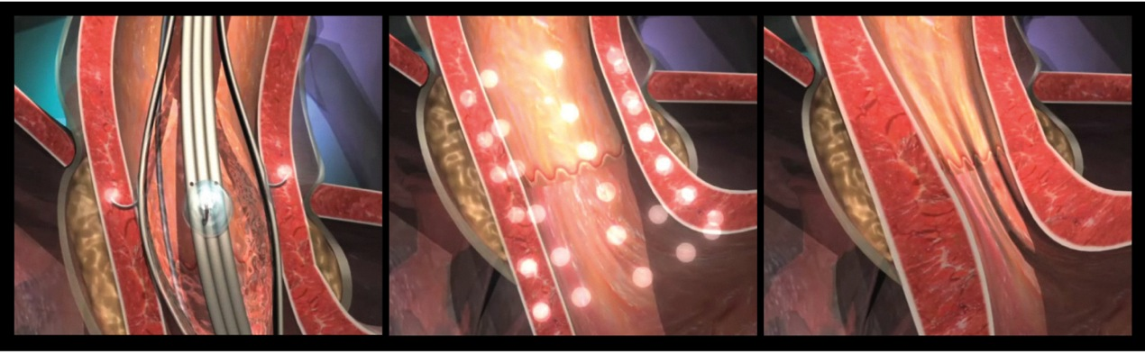
How Stretta Works
Radiofrequency energy delivered to tissue
Multi-level treatment remodels the LES muscle
Barrier function and GERD symptoms are significantly improved
Every patient is different in their response to Stretta Therapy. Some patients see improvements more quickly than others, and studies show that symptoms may continually improve for six months or longer. A continuation of anti-secretory medications for two-months after Stretta and a modified diet are recommended for two weeks.

Slide 17

Resolve Reflux. Reduce or Eliminate Meds. Avoid Invasive Surgery.
Ask your Doctor if Stretta Therapy is right for you.
www.stretta-therapy.com
Notes:
Patients return to most activities the next day. Studies show that 92% of Stretta patients are satisfied with their treatment and that improvement in symptoms is sustained for up to 4 years. These satisfied patients report improvements in quality of life and many are able to discontinue medications

Slide 18
INDICATIONS FOR USE: The Stretta System is intended for general use in the electrosurgical coagulation of tissue and intended for use specifically in the treatment of gastroesophageal reflux disease (GERD).
CONTRAINDICATIONS: The use of electrosurgery is contraindicated when, in the judgment of the physician, electrosurgical procedures would be contrary to the best interest of the patient. The following is a list of patient groups in which the use of the Stretta System for the treatment of GERD is contraindicated: subjects under the age of 18, pregnant women, patients without a diagnosis of GERD, hiatal hernia >2cm, achalasia or incomplete LES relaxation in response to
swallow, poor surgical candidates, ASA IV classification, patients with an implant near the LES could be conductive with RF energy.
WARNINGS: These complications are rarely seen but could potentially occur with the use of electrosurgery for the treatment of GERD: transient bleeding, bloating, transient chest pain, transient difficulty belching, transient dysphagia, transient epigastric discomfort, transient esophageal mucosal laceration, transient fever, Injury to esophageal mucosa, perforation, pharyngitis, vomiting,transient with potential for bleeding or Esophageal injury. If any vomiting occurs, contact your treating physician immediately. Excessive vomiting may result in perforation and more serious injury resulting in death. The following complications have not been seen, but could possibly occur infrequently: Achalasia, transient delayed gastric emptying, dental injury, dyspnea, infection, larynx injury, worsened GERD (Note: Consult instructions for use for full contraindications, warnings and precautions).

